Slide 1
Application Types in Microsoft Identity
Notes:
In this unit, you’ll learn how to create, configure, and use Azure AD applications that use data returned from Microsoft Graph in single-page applications by using the OAuth 2.0 implicit grant flow.

Slide 2

Overview
Single Page Apps (SPAs)
OAuth 2.0 implicit grant flow
Azure AD app registration
MSAL & code configuration
Sign-in & obtain access token
Call APIs
Web Apps that call APIs
Daemon / Service Apps

Slide 3
Single Page Applications (SPAs)
Notes:
In this first section we’ll look at single page applications

Slide 4
Single Page Applications
Modern web applications can be built entirely client-side with JavaScript
Optionally leverage web framework (React, Angular, Vue, etc)
Run entirely in a web browser – no (or minimal) server-side component
Have unique authentication characteristics & challenges compared to traditional server-side web apps
Notes:
Web standards and modern browsers have advanced considerably in recent years to the point that developers can create sophisticated client-side applications. These client-side applications, also referred to as single-page applications (SPAs), can enable users to authenticate and obtain tokens from Microsoft identity platform that can be used to call secured web APIs.
Many modern web applications are built as client-side SPAs written using JavaScript or a SPA framework such as Angular, Vue, or React. These applications run in a web browser and have different authentication characteristics than traditional server-side web applications. The Microsoft identity platform enables SPAs to sign in users and get tokens to access backend services or web APIs using the OAuth 2.0 implicit flow. The implicit flow allows the application to get ID tokens to represent the authenticated user and also access tokens needed to call protected APIs.

Slide 5
SPAs have unique challenges related to authentication
Security characteristics of these apps are different from traditional server-based web applications
Many authorization servers and identity providers don't support CORS requests
Full-page browser redirects away from the app become invasive to the user experience
Notes:
SPAs and other JavaScript apps that run primarily in a browser have unique challenges when it comes to authentication:
- Security characteristics of these apps are different from traditional server-based web applications
- Many authorization servers and identity providers don't support CORS requests
- Full-page browser redirects away from the app become invasive to the user experience

Slide 6
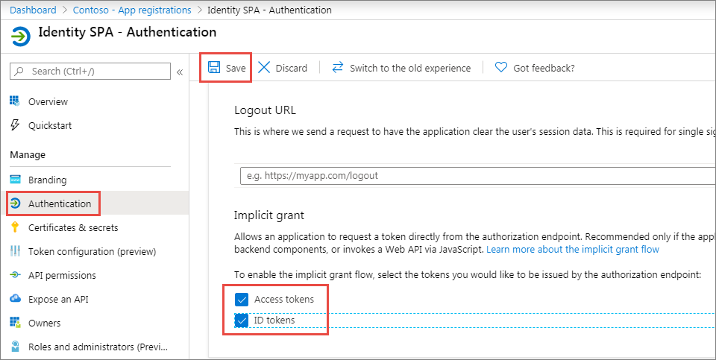
Azure AD app registration
SPA must have an associated Azure AD app registration to support user sign-in & obtain access token
By default, Azure AD apps don’t support
the OAuth 2.0 implicit flow
It must be manually enabled
Specify redirect URI & enable ID token
Optionally enable access token
Notes:
In order for a SPA to use Microsoft identity to enable users to authenticate and obtain access tokens for use with services such as Microsoft Graph, you must register a new app with Azure AD. You can do this using the Azure AD admin center https://aad.portal.azure.com.
By default, Azure AD apps don't support the OAuth 2.0 implicit grant flow. After registering the Azure AD app, there are a few things you need to do.
First, ensure the redirect URI of the app points to the URL of the SPA. This URL must match the redirect URL provided by the SPA when the authentication process is initiated.
Next, ensure the implicit flow is enabled by selecting the **ID token** option on the app's authentication settings. If the app is also going to request an access token to use in authenticating requests to other Microsoft identity-protected endpoints, you must also select the **Access tokens** option.

Slide 7
MSAL JS Configuration
const msalConfig = {
auth: {
clientId: '{{AZUREAD_APP_ID}}',
authority: 'https://login.microsoftonline.com/{{DIRECTORY_ID}}',
redirectURI: 'https://localhost:3007'
},
cache: {
cacheLocation: "localStorage",
storeAuthStateInCookie: true
}
};
const msalApplication = new Msal.UserAgentApplication(msalConfig);
Notes:
The easiest way to use Microsoft identity for authentication and to obtain access tokens to authorize requests to secured endpoints in SPAs is to use the Microsoft Authentication Library (MSAL) for JavaScript.
After adding a script reference to the page, add the following code to obtain an instance of the application:
The app ID and directory ID tokens in the code are placeholders for the values from the Azure AD app.
[!IMPORTANT]
The preferred experience when using MSAL when signing-in and obtaining access tokens is to use a popup window. However, some browsers have known issues with popup windows. In these cases, you can choose to use MSAL's equivalent methods that use browser redirects.

Slide 8
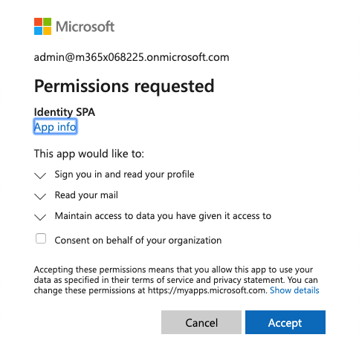
User Sign-in
var loginRequest = {
scopes: ["user.read", "mail.read"]
};
msalApplication.loginPopup(loginRequest)
.then(function (loginResponse) {
let idToken = loginResponse.idToken;
}).catch(function (error) {
console.log(error);
});
Notes:
With the application configured, the next step is for the user to sign in. Do this by calling the `loginPopup()` method and pass in an object with the wanted permissions defined:
This code will open a popup that loads the Azure AD sign-in experience. If the user hasn't signed in previously and granted the app the specified permissions, after a successful sign-in, Azure AD will present the user with the consent experience.
After completing the sign-in experience, MSAL.js will close the sign-in popup and execute the success path of the `loginPopup()` method.

Slide 9
Acquire access token
var accessTokenRequest = { scopes: ["user.read", "mail.read"] };
var accessToken = "";
msalApplication.acquireTokenSilent(accessTokenRequest)
.then(function(accessTokenResponse) {
accessToken = accessTokenResponse.accessToken;
})
.catch(function(error)) {
// failed to obtain token silently & error indicates interactive req…
if (requiresInteractiveLogin(error)) {
msalApplication.acquireTokenPopup(accessTokenRequest)
.then(function(accessTokenResponse) {
accessToken = accessTokenResponse.accessToken;
});
}
});
Notes:
After the user has signed in, the next step is to obtain an access token to use in the authorization header of the request.
There are two methods on the MSAL.js API that you can use for this task:
`acquireTokenSilent()`: If the user has already signed in and an interactive sign-in is not required, this method will return a response that includes the access token:
`acquireTokenPopup()`: if the `acquireTokenSilent()` fails and/or an interactive sign-in is required, you can use this method. It will combine the request to sign-in and obtain an access token in one step:

Slide 10
Calling APIs– Microsoft Graph
getMessagesFromMSGraph(
'https://graph.microsoft.com/v1.0/me/messages?$top=10&$select=subject',
tokenResponse.accessToken
onSuccessGraphCallback);
function getMessagesFromMSGraph(endpoint, accessToken, callback) {
var xmlHttp = new XMLHttpRequest();
xmlHttp.onreadystatechange = function () {
if (this.readyState == 4 && this.status == 200)
callback(JSON.parse(this.responseText));
}
xmlHttp.open("GET", endpoint, true);
xmlHttp.setRequestHeader('Authorization', 'Bearer ' + accessToken);
xmlHttp.send();
}
Notes:
Once your SPA has an access token, you can use it to call the secured endpoint, such as Microsoft Graph:

Slide 11
Demo

Slide 12
OAuth 2.0 implicit flow
Popular way for SPAs to authenticate & obtain access token to connect to protected services
Supported by Microsoft identity platform
Supported by MSAL JS
Notes:
The OAuth 2.0 implicit grant flow is a popular way for these SPAs to authenticate to obtain an access token to connect to protected services. The Microsoft identity platform supports the OAuth 2.0 implicit grant flow.

Slide 13
Thank you.

